Slide 1


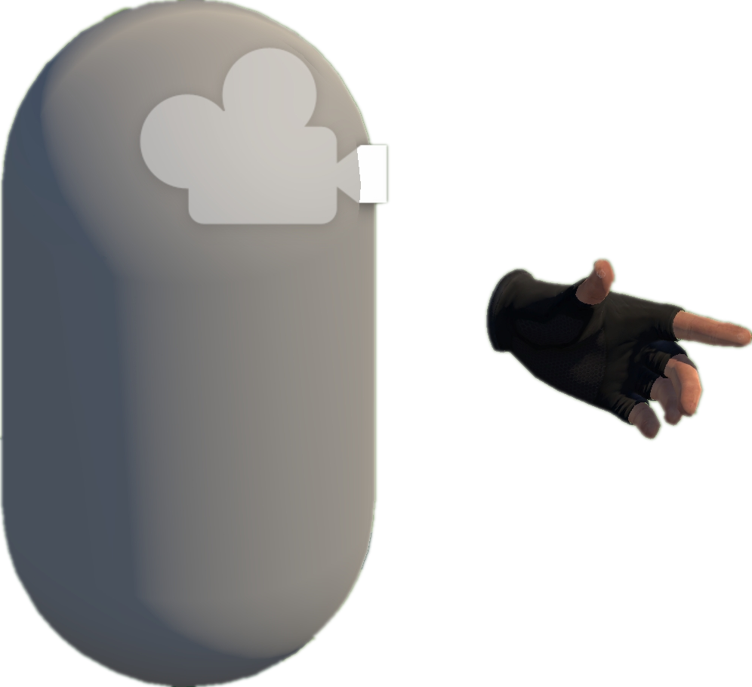







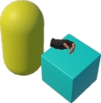
A
Project Collection (§3.2)
E
VRExplorer Test (§3.5)
3
Behavior Execution and Scene Exploration
Preliminary Scene Configuration
Open Source
Repositories
Tags & Topics
1
Camera
Unity-based
Projects
Bake NavMesh
Scene with NavMesh (facilitates agent navigation in the Unity scene)
Hand Controller
Original Scene
Collider
High-Quality Unity VR Projects
Manifest Validation
& Manual Check
VRExplorer Agent
Implementation Interface
Interaction & Scene Analysis
2
Customizing Entity Interface Configuration
PFSM
Autonomous Event Invocation
All Scripts
Project Analysis (§3.2)
Core Scripts
B
Decision Making
Task Execution
Hierarchy Analysis
Game Logic Code & Third Plugin Analysis
Scripts Implemented
Entity Interface
Task Execution
Autonomous
Event Invocation
Environment
Interactables
Box
Input Next
Interactable’s Mono
Output
Task
Model
EAT Framework (§3.4)
D
Task Generator
C
Model Abstraction (§3.3)
Task Generator & Customized Task Model
Example Task Model
Abstraction Object Interaction Feature
Parallel and serial combinations
Grab-And-Drag-Box Task
Triggerable
Base Action
Move to Approcach
Parallel Action
Button, Joystick
Inherit
Move Action
Grab Action
Triggerable & Grabbable
Grab Action
Trigger Action
Grab
Gun, Cigarette Lighter
Move Action
Grabbable
Box, Coin
Trigger
Walk Around
Asynchronous Action
Grab
Base Entity
Abstraction Action
Inherit
Press
Pressing
Trigger Action
+ Triggering Time
+ Triggering() + Triggered()
Grabbable Entity
Triggerable Entity
Task Layer
Pressed
Entity Interface
C# Scripts File
Pull
Pulling
Action Layer
Relaxed
Unity Scene
GameObjects
Fire
Pulling the trigger
Implement
Entity Layer
Triggered
XR Box
XR Joystick
XR Button
Mono Scripts
Third Plugin / Package
Notes:
单击此处添加文本

